Slide 1


数据库原理(H)答辩
吴梦轩
12212006

Slide 2
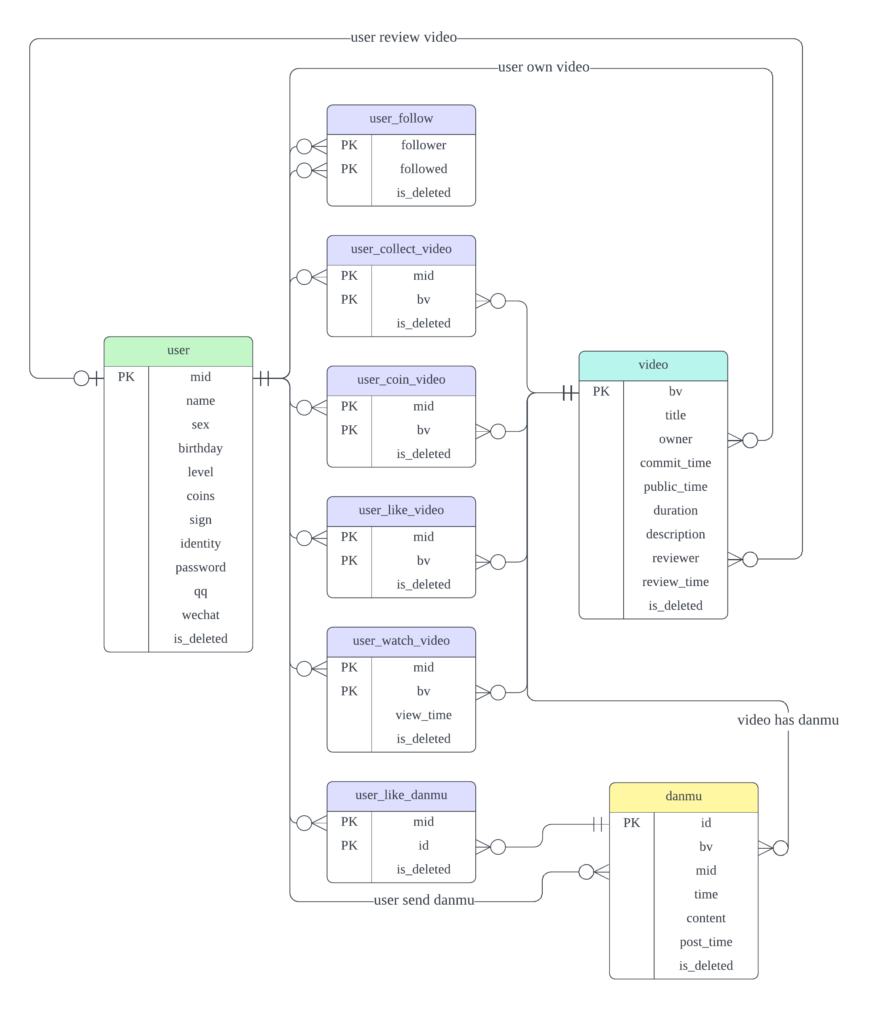
ERD: Crow’s Foot Model

Slide 3
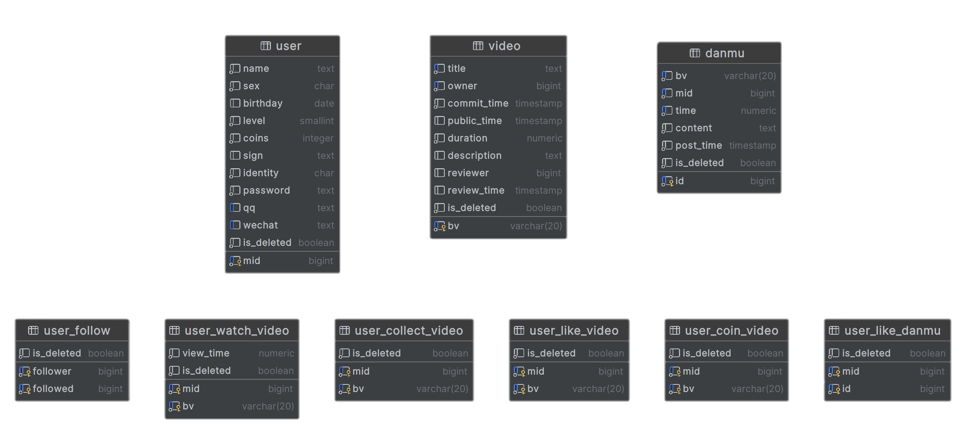
Database Visualization
Entity
Relation

Slide 4
Design: No Foreign Key
Bad for Database Partitioning
User Table 1
User Table 2
Cascade
Video Table

Slide 5
Design: Soft Delete

Slide 6
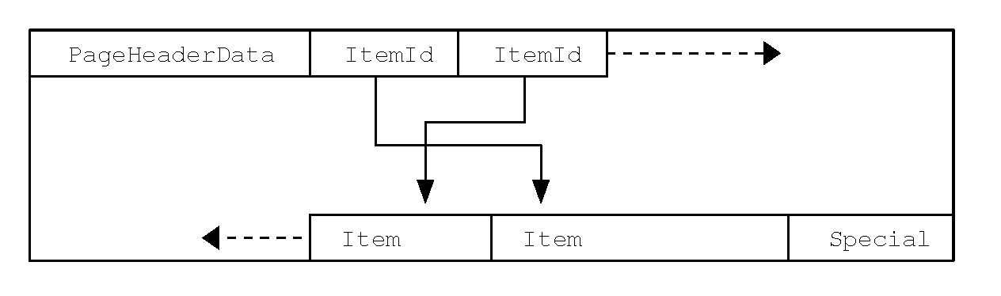
Design: Soft Delete
Why not
history table?
Problem of Bloat
Transaction Read
Transaction Read
Transaction Update
Tuple 1
Tuple 2
Row 1

Slide 7
Design: Soft Delete
Performance
Problem?
Uniqueness
Issue?

Slide 8
Design: Soft Delete
Performance
Problem?
Uniqueness
Issue?
Partial Index
CREATE UNIQUE INDEX uk_user_qq
ON "user"(qq)
WHERE is_deleted = FALSE;

Slide 9
Design: Soft Delete
Combine
Partial Index
With
Covering Index
CREATE UNIQUE INDEX uk_user_qq
ON "user"(qq)
INCLUDE (identity)
WHERE is_deleted = FALSE;

Slide 10
Design: Soft Delete
Harder SQL?
View On Only Visible Rows
CREATE VIEW videos_visible AS SELECT * FROM video
WHERE is_deleted = FALSE;

Slide 11
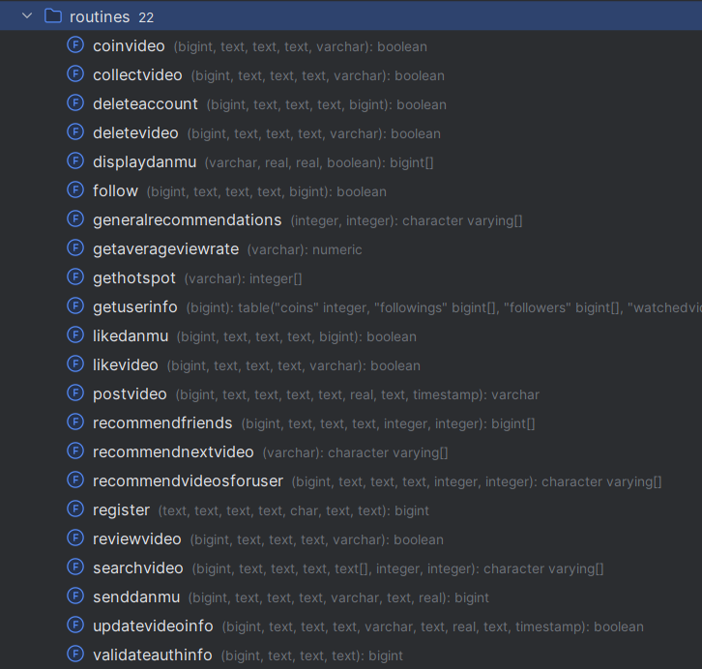
Design: Performance
Minimize Connection
And
Data Transmission

Slide 12
Design: Performance
Function Cache

Slide 13
Design: Performance
Easier
Function Call

Slide 14
Design: Performance
Grant Privilege
‘EXECUTE’
to User/Role

Slide 15
Design: Performance
Batching
And
Rewrite Batched Insert
INSERT INTO users (username, email)
VALUES ('user1', 'user1@example.com');
INSERT INTO users (username, email)
VALUES ('user2', 'user2@example.com');
INSERT INTO users (username, email)
VALUES ('user3', 'user3@example.com');
INSERT INTO users (username, email)
VALUES
('user1', 'user1@example.com’),
('user2', 'user2@example.com’),
('user3', 'user3@example.com');

Slide 16
Design: Performance
Multi-Thread
User Data 1
User Data 2
User Data 3
User Data 4
User Table

Slide 17
Design: Performance
Drop Index and Reindex
(Also Works for Foreign Key)
Maintain index with every insert
446028ms
Create index after insert
270521ms

Slide 18
Design: Security
CREATE TABLE crypto_password(
id INT NOT NULL,
password VARCHAR(255) NOT NULL,
PRIMARY KEY (id)
);
INSERT INTO crypto_password
VALUES (1, crypt(’my password’, gen_salt(’bf’)));
Protects User Privacy:
Password, qq, wechat

Slide 19
Design: Security
CREATE TABLE crypto_password(
id INT NOT NULL,
password VARCHAR(255) NOT NULL,
PRIMARY KEY (id)
);
INSERT INTO crypto_password
VALUES (1, crypt(’my password’, gen_salt(’bf’)));
Protects User Privacy:
Password, qq, wechat

Slide 20
Design: Security
SELECT password = crypt(’my password’, password)
FROM crypto_password
WHERE id = 1;
Protects User Privacy:
Password, qq, wechat

Slide 21
Thank you!

